Slide 1


SURVEY RESEARCH METHODS IN SOFTWARE ENGINEERING
Prof. Marcos Kalinowski
kalinowski@inf.puc-rio.br
http://www.inf.puc-rio.br/~kalinowski
@prof_kalinowski

Slide 2






Introductions ...
Professor at the Department of Informatics (DI) of PUC-Rio
Coordinator of the ExACTa PUC-Rio Lab @ DI PUC-Rio
M.Sc And Ph.D level advisor in the areas of Software Engineering and Data Science
Member of the ISERN (International Software Engineering Research Network)
kalinowski@inf.puc-rio.br
http://www.inf.puc-rio.br/~kalinowski
@prof_kalinowski
http://www.linkedin.com/in/kalinowski/

Slide 3



October 2023
‹#›

Slide 4


Among the top-ranked
universities and leader in industry integration in Latin America, according to Times Higher Eduction
First Brazilian graduate program in Computing, assessed with the highest research quality score (7/7) by the Brazilian Federal Government
R&D in Software Engineering, Data Science, and Human-Computer Interaction
October 2023
‹#›

Slide 5

Agenda
1
INTRODUCTION TO SURVEY RESEARCH
Characteristics and Purposes
Examples of Surveys
2
SURVEY DESIGN
Basics of Survey Design
Goal-Question-Metric Driven Design
Theory-Driven Design
Issues When Assessing Psychological Constructs
Survey Instrument Evaluation
3
SAMPLING
Representativeness
Sample Size Estimation
Ethics

Slide 6

Agenda
4
DATA COLLECTION
Invitation and Follow-Up
5
STATISTICAL ANALYSIS
Descriptive Statistics
Null-hypothesis Significance Testing
Bootstrapping Confidence Intervals
Bayesian Analysis
Structural Equation Modeling
6
QUALITATIVE ANALYSIS
Grounded Theory Procedures
8
HANDS-ON EXERCISE
7
THREATS TO VALIDITY AND RELIABILITY

Slide 7


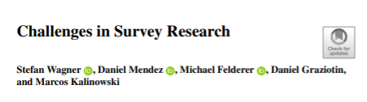
Bibliography
Wagner, S., Mendez, D., Felderer, M., Graziotin, D. and Kalinowski, M., 2020. Challenges in survey research. In: Contemporary Empirical Methods in Software Engineering (pp. 93-125). Springer, Cham.
Linåker, J., Sulaman, S.M., Maiani de Mello, R. and Höst, M., 2015. Guidelines for conducting surveys in software engineering. Technical Report.
Kitchenham, B.A. and Pfleeger, S.L., 2008. Personal opinion surveys. In Guide to advanced empirical software engineering (pp. 63-92). Springer, London.
Fowler Jr, F.J., 2013. Survey research methods. Sage publications.
+ Specific methodological and survey articles cited throughout the course.

Slide 8




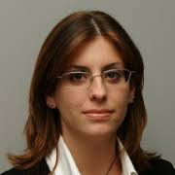


















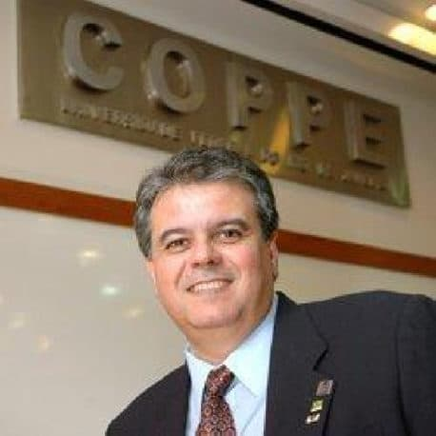

Acknowledgments
T. Baldassarre
S. Baltes
S. Biffl
T. Conte
M. Genero
M. Kuhrmann
E. Mendes
R. Prikladnicki
S. Wagner
D. Mendez
M. Felderer
D. Graziotin
P. Ralph
M.A. Storey
G. Travassos
C. Wohlin

Slide 9
INTRODUCTION TO SURVEY RESEARCH

Slide 10
Characteristics
Surveys are probably the most commonly used research method worldwide
Surveys are conducted when a phenomena (e.g., the use of a technique or tool) already has taken place or before it occurs
A survey provides no control of the execution or measurement
I.e., it is not possible to manipulate variables as in the other investigation methods
Surveys should aim at obtaining the largest amount of understanding from the fewest number of variables since this reduction also eases the data collection and analysis
Surveys are almost never conducted to create an understanding concerning a particular sample, the typical focus is on generalizing results to the population from which the sample was drawn.
Notes:
It may be possible to compare survey results.

Slide 11


Purpose
General objectives for conducting a survey (Wohlin et al., 2012; Wagner et al., 2020):
EXPLORATIVE
SURVEYS
DESCRIPTIVE
SURVEYS
EXPLANATORY
SURVEYS
are used as a pre-study to a more thorough investigation to assure that important issues are not forgotten (e.g., constructs in a theory like requirements elicitation techniques)
can be conducted to enable assertions about some population like the distribution of certain attributes (e.g., usage of requirements elicitation techniques)
aim at making explanatory claims about the population (e.g., why specific requirements elicitation techniques are used in specific contexts)
October 2023

Slide 12


Characteristics and Purpose
Theory building and evaluation can guide the design and analysis of surveys, and surveys can also be applied to test theories.
(Wagner et al., 2020)
Wagner, S., Mendez, D., Felderer, M., Graziotin, D. and Kalinowski, M., 2020. Challenges in survey research. In: Contemporary Empirical Methods in Software Engineering (pp. 93-125). Springer, Cham.
October 2023

Slide 13
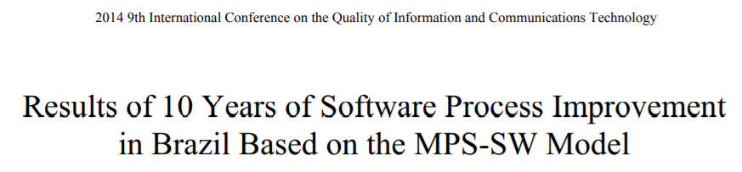
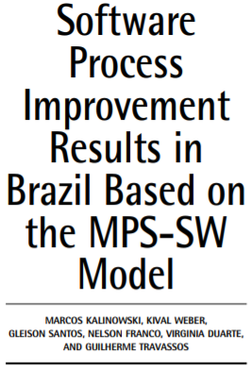
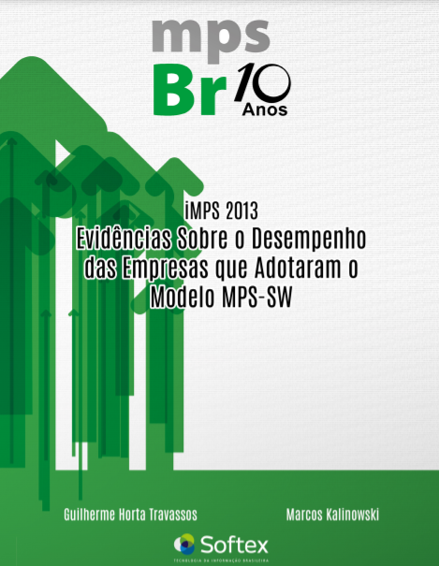
Examples of Surveys
Kalinowski, M., Weber, K., Franco, N., Barroso, E., Duarte, V., Zanetti, D. and Santos, G., 2014, September. Results of 10 years of software process improvement in Brazil based on the MPS-SW model. In 2014 9th International Conference on the Quality of Information and Communications Technology (pp. 28-37).
Kalinowski, M., Weber, K., Santos, G., Franco, N., Duarte, V. and Travassos, G., 2015. Software Process Improvement Results in Brazil Based on the MPS-SW Model. Software Quality Professional, 17(4): 15-28.
Travassos, G.H. and Kalinowski, M., 2014. iMPS 2013: Evidence on performance of organizations that adopted the MPS-SW. Campinas, Brazil: Softex.
https://softex.br/mpsbr/pesquisas-mps/
October 2023

Slide 14
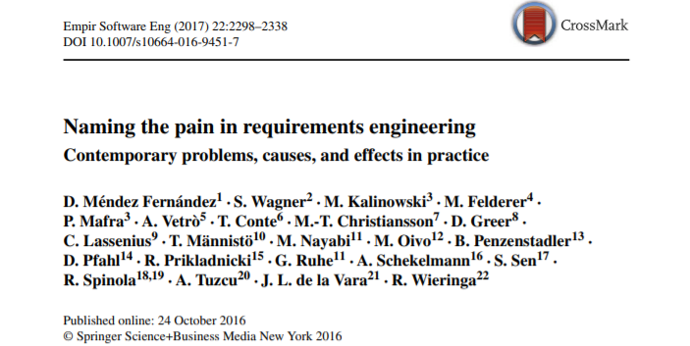

Examples of Surveys
Fernández, D. M.; Wagner, S.; Kalinowski, M.; Felderer, M.; Mafra, P.; Vetro, A.; Conte, T.; Christiansson, M.; Greer, D.; Lassenius, C.; Männistö, T.; Nayabi, M.; Oivo, M.; Penzenstadler, B.; Pfahl, D.; Prikladnicki, R.; Ruhe, G.; Schekelmann, A.; Sen, S.; Spínola, R. O.; Tuzcu, A.; de la Vara, J. L.; and Wieringa, R. Naming the pain in requirements engineering - Contemporary problems, causes, and effects in practice. Empirical Software Engineering, 22(5): 2298-2338. 2017.
October 2023

Slide 15

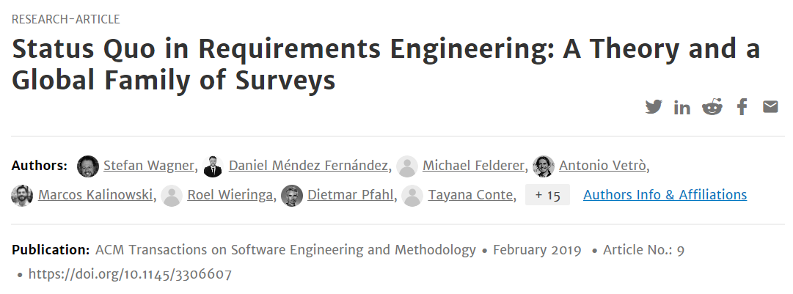
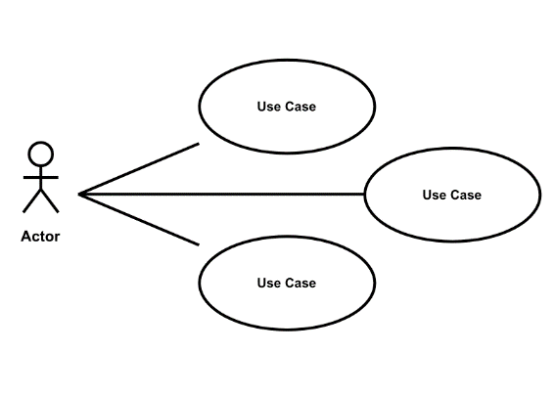
Examples of Surveys
Wagner, S., Fernández, D. M., Felderer, M., Vetro, A., Kalinowski, M., Wieringa, R., Pfahl, D., Conte, T., Christiansson, M., Greer, D., Lassenius, C., Männistö, T., Nayebi, M., Oivo, M., Penzenstadler, B., Prikladnicki, R., Ruhe, G., Schekelmann, A., Sen, S., Spínola, R.O., Tuzcu, A., de la Vara, J. L., and Winkler, D, Status Quo in Requirements Engineering: A Theory and a Global Family of Surveys. ACM Transactions on Software Engineering and Methdology, 28(2): 9:1-9:48. 2019.
October 2023

Slide 16

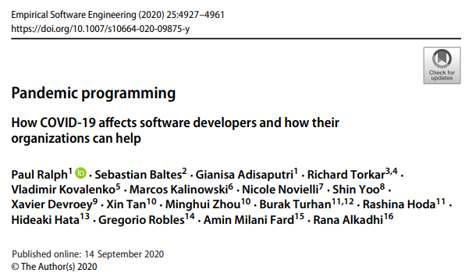

Examples of Surveys
Ralph, P., Baltes, S., Adisaputri, G., Torkar, R., Kovalenko, V., Kalinowski, M., Novielli, N., Yoo, S., Devroey, X., Tan, X., Zhou, M., Turhan, B., Hoda, R., Hata, H., Robles, G., Fard, A. M., and Alkadhi, R, Pandemic Programming How COVID-19 affects software developers and how their organizations can help. Empirical Software Engineering (2020), 25: 4927-4961. 2020.
October 2023

Slide 17
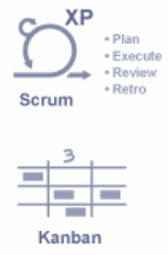
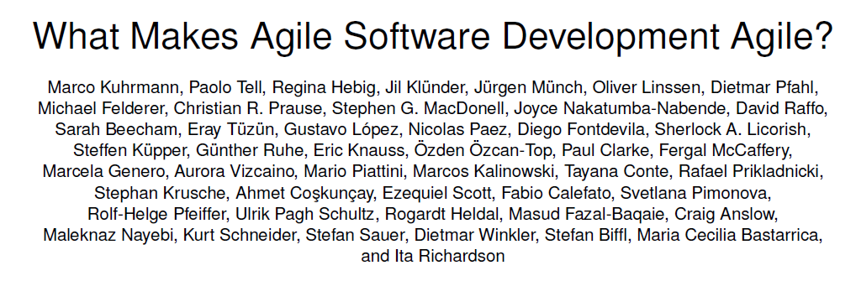
Examples of Surveys
Kuhrmann, M., Tell, P., Hebig, R. et al. What Makes Agile Software Development Agile? Submitted to Transactions on Software Engineering (2021).
October 2023

Slide 18
SURVEY DESIGN

Slide 19

Survey Design
Basics of Survey Design
Goal-Question-Metric-Driven Design
Theory-Driven Design
Issues When Assessing Psychological Constructs
Survey Instrument Evaluation
October 2023
Notes:
It may be possible to compare survey results.

Slide 20
Basics of Survey Design
QUESTIONNAIRE TYPES
QUESTION CATEGORIES
Self-administered questionnaire
Interviewer-administered questionnaire
Demographic questions
Substantive questions
Filter questions
Sensitive questions
QUESTION TYPES
Open-ended
Close-ended
Hybrid questions
October 2023
Notes:
Sensitive questions collect sensitive information, such as religious aliation,
ethnicity, sexual practices, income and opinion about highly controversial
ethical, political and moral issues

Slide 21



Basics of Survey Design
Measurement scales
Conditions that must be fulfilled to get appropriate responses
Nominal
Values can be counted
Questions must be understandable by the target population
Ordinal
Values can be counted and ordered
e.g. Likert
Respondents must have sufficient knowledge to answer
More Information
Interval
Values can be counted and ordered
Distance between values can be interpreted
Participants must be motivated and willing to participate
Ratio
Values can be counted and ordered
Distance between values can be interpreted
Radio between values can be interpreted
October 2023

Slide 22

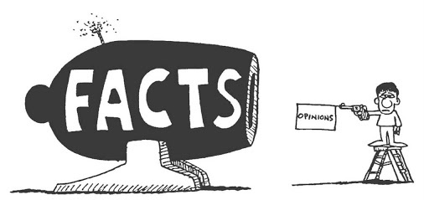
Basics of Survey Design
Suggestions to avoid common question wording problems
(adapted from Kitchenham and Pfleeger, 2008)
In a survey, we can either ask for the opinions of the participants on topics or for specific facts that they experienced.
Using appropriate and simple language
Avoiding technical terms
Keeping questions short
Avoiding vague sentences
Avoiding sensitive questions
Avoiding too demanding questions
Avoiding double-barreled questions
Avoiding double negatives
Avoid asking about long gone events
October 2023

Slide 23
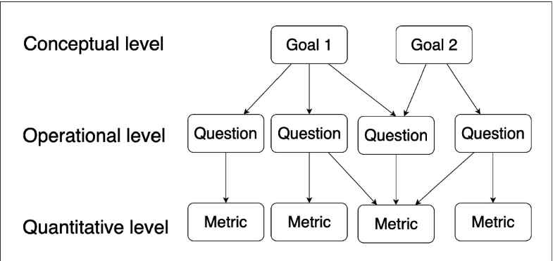
Goal-Question-Metric-Driven Design
Based on the Goal Question Metric (GQM) Paradigm (Basili and Romback, 1988)
GQM defines a way to plan and execute measurement and analysis activities:
1
Starts with the declaration of the measurement, Goals
2
From the goals, Questions that we would like to answer with the data interpretation are defined
3
Finally, from the questions, the Metrics and the data to be collected are defined
Basili, V.R. and Rombach, H.D., 1988. The TAME project: Towards improvement-oriented software environments. IEEE Transactions on software engineering, 14(6), pp.758-773.
October 2023

Slide 24
Goal Definition Template
Analyze <object of study>
with the purpose of <goal>
with respect to <quality focus>
from the point of view of the <perspective> in the context of <context>
Measurement activities need clear goals
GQM: characterize, understand, evaluate, predict, improve.
Basili, V.R. and Rombach, H.D., 1988. The TAME project: Towards improvement-oriented software environments. IEEE Transactions on software engineering, 14(6), pp.758-773.
October 2023
Notes:
Goal: characterize -> understand -> evaluate -> predict -> improve

Slide 25


Slide 26
Goal Definition Template (Example)
GOAL
Analyze the profile of software development organizations
with the purpose of characterizing
with respect to the organizations’ current profile, satisfaction degree regarding the MPS model, variation of presence in international markets, variation of exportation volume, and variation concerning cost, estimation accuracy, productivity, quality, user satisfaction, and return of investment (ROI)
from the point of view the software development organizations
in the context of software development organizations with unexpired MPS-SW assessments published in the SOFTEX portal
Kalinowski, M., Weber, K.C. and Travassos, G.H., 2008, October. iMPS: an experimentation based investigation of a nationwide software development reference model. In Proceedings of the Second ACM-IEEE international symposium on Empirical Software Engineering and Measurement (ESEM).
October 2023
Notes:
Goal: characterize -> understand -> evaluate -> predict -> improve

Slide 27
Further Goal-Question-Metric-Driven Design Examples
“Analyze Social BPM with the purpose of characterizing with respect to adoption of its practices and technologies during the BPM lifecycle from the point of view of BPM participants or managers In the context of Brazilian organizations.”
Batista, M., Magdaleno, A. and Kalinowski, M., 2017, May. A Survey on the use of Social BPM in Practice in Brazilian Organizations. In Anais do XIII Simpósio Brasileiro de Sistemas de Informação (SBSI) (pp. 436-443). SBC.
“Analyze V&V methods with the purpose of characterization with respect to their suitability for addressing ISO 25010 software quality characteristics from the point of view of experts in the area of V&V in the context of the software engineering research community.”
Mendoza, I., Kalinowski, M., Souza, U. and Felderer, M., 2019, January. Relating verification and validation methods to software product quality characteristics: results of an expert survey. In Proc. of the Software Quality Days Conference (SWQD) (pp. 33-44).

Slide 28


Slide 29
Goal Definition Template (Example)
GOAL
Analyze software development organizations
with the purpose of characterizing
with respect to the organizations’ current profile, satisfaction degree regarding the MPS model, variation of presence in international markets, variation of exportation volume, and variation concerning cost, estimation accuracy, productivity, quality, user satisfaction, and return of investment (ROI)
from the point of view the software development organizations
in the context of software development organizations with unexpired MPS-SW assessments published in the SOFTEX portal
Kalinowski, M., Weber, K.C. and Travassos, G.H., 2008, October. iMPS: an experimentation based investigation of a nationwide software development reference model. In Proceedings of the Second ACM-IEEE international symposium on Empirical Software Engineering and Measurement (ESEM).
October 2023
Notes:
Goal: characterize -> understand -> evaluate -> predict -> improve

Slide 30
Question and Metrics (1/2)
QUESTION
Q1: What is the organization’s estimation accuracy?
METRICS
M1.1: Average Project Duration = Average duration of projects conducted within the last 12 months, measured in months.
M1.2: Average Project Estimated Duration = Average estimated duration of projects conducted within the last 12 months, measured in months.
M1.3: Estimation Accuracy = 1 - |((Average Project Duration – Average Project Estimated Duration) / Average Project Duration)|
Kalinowski, M., Weber, K.C. and Travassos, G.H., 2008, October. iMPS: an experimentation based investigation of a nationwide software development reference model. In Proceedings of the Second ACM-IEEE international symposium on Empirical Software Engineering and Measurement (ESEM).
October 2023
Notes:
What kind of questions would you include in your survey?

Slide 31
Question and Metrics (2/2)
QUESTION
Q2: What is the organization’s Return of Investment (RoI) of adopting MPS-SW?
METRICS
M2.1: Variation in net sales = Percentage of variation in net sales.
M2.2: Investment in implementing MPS = Percentage of net sales invested in implementing MPS
M2.3: Investment in assessing MPS = Percentage of net sales invested in the MPS assessment
M2.4: ROI = (Variation in net sales / (Investment in implementing MPS + Investment in assessing MPS)) * 100
Kalinowski, M., Weber, K.C. and Travassos, G.H., 2008, October. iMPS: an experimentation based investigation of a nationwide software development reference model. In Proceedings of the Second ACM-IEEE international symposium on Empirical Software Engineering and Measurement (ESEM).
October 2023
Notes:
What kind of questions would you include in your survey?

Slide 32
Theories in Software Engineering
A theory provides explanations and understanding in terms of basic constructs and underlying mechanisms, which constitute an important counterpart to knowledge of passing trends and their manifestation (Hannay et al. 2007):
From the practical perspective, theories should be useful and explain or predict phenomena that occur in software engineering
From a scientific perspective, theories should guide and support further research in software engineering
THEORY BUILDING BLOCKS
(Sjøberg et al., 2008)
Constructs
Propositions
Explanations
Scope
October 2023

Slide 33
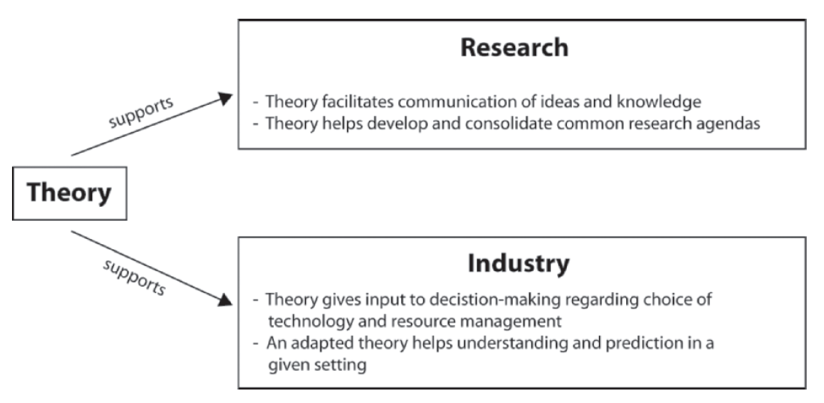
Theories in Software Engineering
Sjøberg, D.I., Dybå, T., Anda, B.C. and Hannay, J.E., 2008. Building theories in software engineering. In Guide to advanced empirical software engineering (pp. 312-336). Springer, London.
October 2023

Slide 34
Theory-Driven Design
Theory building and evaluation can guide the design and analysis of surveys, and surveys can also be applied to test theories.
(Wagner et al., 2020)
Theory building and survey research are strongly interrelated
Initial theories can be drawn from observations and available literature
An initial theory may be a taxonomy of constructs or a set of statements relating constructs
For NaPiRE, a set of constructs and propositions was elaborated based on available literature and expert knowledge,
For Pandemic Programming, a theoretical model was designed based on related work
The surveys, in both cases, were designed to test the theory (and to potentially extend it)
October 2023

Slide 36
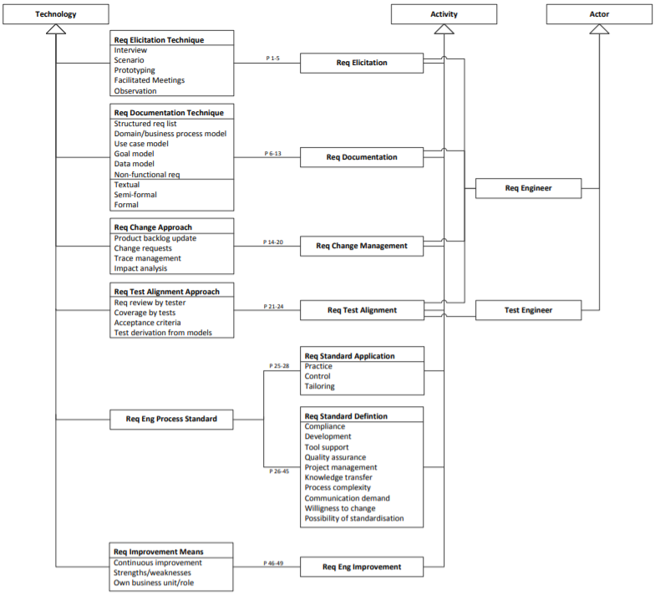
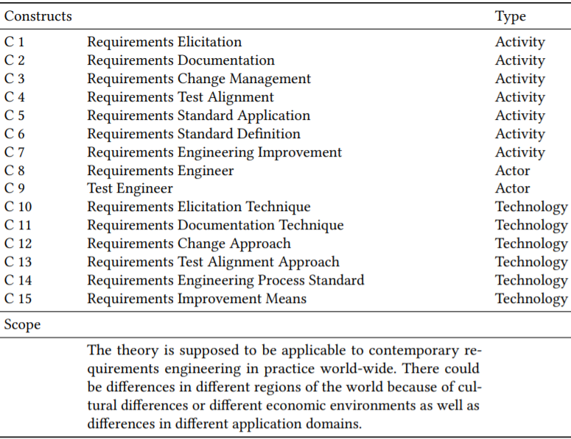
Theory-Driven Design Example: NaPiRE
INITIAL THEORY
Wagner, S. et al. Status Quo in Requirements Engineering: A Theory and a Global Family of Surveys. ACM Transactions on Software Engineering and Methdology, 28(2): 9:1-9:48. 2019.
‹#›

Slide 37
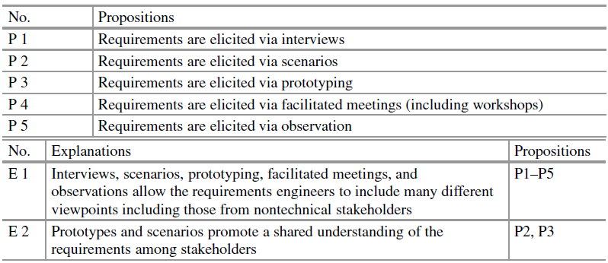
Theory-Driven Design Example: NaPiRE
Wagner, S. et al. Status Quo in Requirements Engineering: A Theory and a Global Family of Surveys. ACM Transactions on Software Engineering and Methdology, 28(2): 9:1-9:48. 2019.
October 2023

Slide 38
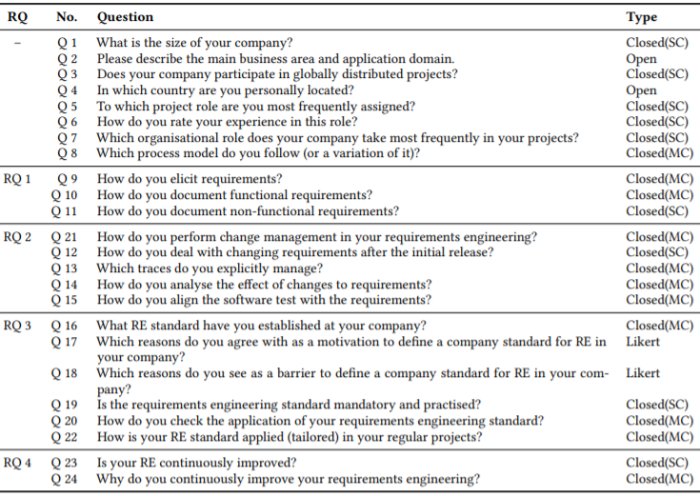
Theory-Driven Design Example: NaPiRE
DESIGNED QUESTIONNAIRE
RQ 1 How are requirements elicited and documented?
RQ 2 How are requirements changed and aligned with tests?
RQ 3 How are RE standards applied and tailored?
RQ 4 How is RE improved?
Wagner, S. et al. Status Quo in Requirements Engineering: A Theory and a Global Family of Surveys. ACM Transactions on Software Engineering and Methdology, 28(2): 9:1-9:48. 2019.
October 2023
‹#›

Slide 39
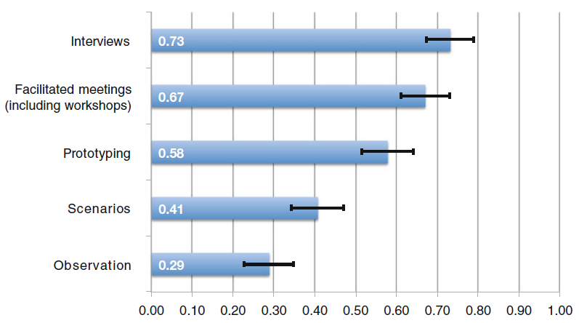
Theory-Driven Design Example: NaPiRE
Wagner, S. et al. Status Quo in Requirements Engineering: A Theory and a Global Family of Surveys. ACM Transactions on Software Engineering and Methdology, 28(2): 9:1-9:48. 2019.
October 2023

Slide 40
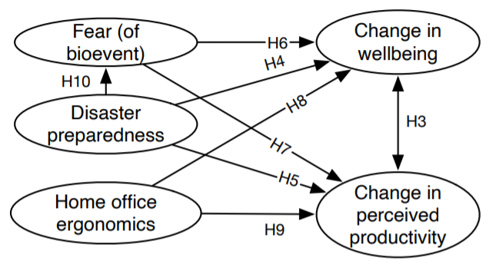
Theory-Driven Design Example: Pandemic Programming
INITIAL THEORY
Ralph, P., Baltes, S., Adisaputri, G., Torkar, R., Kovalenko, V., Kalinowski, M., Novielli, N., Yoo, S., Devroey, X., Tan, X., Zhou, M., Turhan, B., Hoda, R., Hata, H., Robles, G., Fard, A. M., and Alkadhi, R, Pandemic Programming How COVID-19 affects software developers and how their organizations can help. Empirical Software Engineering (2020), 25: 4927-4961. 2020.
October 2023

Slide 41
Theory-Driven Design Example: Pandemic Programming
SELECTING VALIDATED SCALES FOR THE CONSTRUCTS
Change in wellbeing
We used the WHO’s five-item wellbeing index (WHO-5)
Fear (of bioevent)
We adapted the Bracha-Burkle Fear and Resilience (FR) checklist, a triage tool for assessing patients’ reactions to bioevents (including pandemics).
Change in perceived productivity
We used items from the WHO’s Health and Work Performance Questionnaire (HPQ)
We could not find a reasonable scale. Based on our reading of the ergonomics literature, we made a simple six-item, six-point Likert scale concerning distractions, noise, lighting, temperature, chair comfort and overall ergonomics.
Home office ergonomics
Disaster preparedness
We adapted Yong et al.’s (2017) individual disaster preparedness scale
October 2023

Slide 42
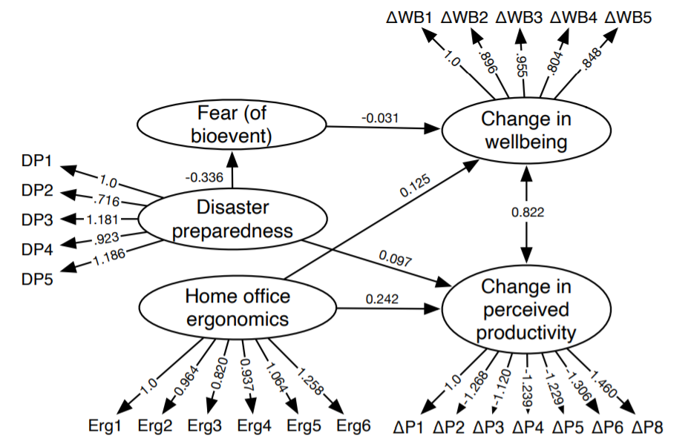
Theory-Driven Design Example: Pandemic Programming
SUPPORTED MODEL
Ralph, P., Baltes, S., Adisaputri, G., Torkar, R., Kovalenko, V., Kalinowski, M., Novielli, N., Yoo, S., Devroey, X., Tan, X., Zhou, M., Turhan, B., Hoda, R., Hata, H., Robles, G., Fard, A. M., and Alkadhi, R, Pandemic Programming How COVID-19 affects software developers and how their organizations can help. Empirical Software Engineering (2020), 25: 4927-4961. 2020.
October 2023

Slide 43
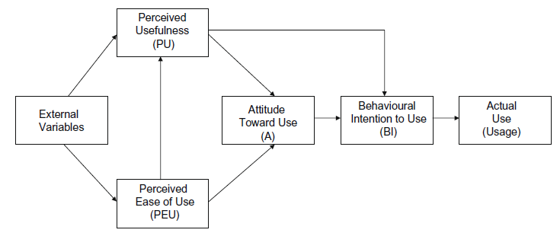
Theory-Driven Design Example: Technology Acceptance Model
TAM THEORY
The technology acceptance model (TAM) is an information systems theory that models how users come to accept and use a technology.
Criticisms of TAM as a "theory" include its limited explanatory and predictive power, triviality, and lack of practical value
The original TAM model (Davis,1989 apud Turner et al., 2010).
Turner, M., Kitchenham, B., Brereton, P., Charters, S. and Budgen, D., 2010. Does the technology acceptance model predict actual use? A systematic literature review. Information and software technology, 52(5), pp.463-479.
October 2023

Slide 44
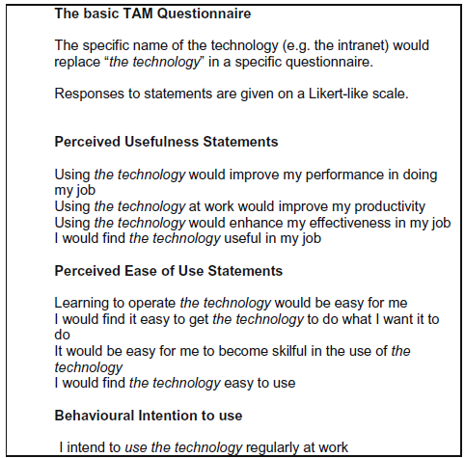
Theory-Driven Design Example: Technology Acceptance Model
TAM QUESTIONNAIRE
The variables within the TAM are typically measured using a short, multiple-item questionnaire
Turner, M., Kitchenham, B., Brereton, P., Charters, S. and Budgen, D., 2010. Does the technology acceptance model predict actual use? A systematic literature review. Information and software technology, 52(5), pp.463-479.
October 2023

Slide 45
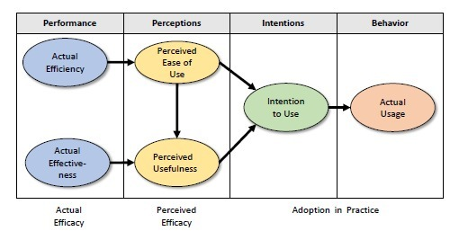
Theory-Driven Design Example: Technology Acceptance Model
Alternatives for technology acceptance …
Unified theory of acceptance and use of technology (Venkatesh et al., 2003) *
Technology Acceptance Model (Davis, 1989) **
Matching Person & Technology model (Sherer, 1986)
Diffusion of Innovations Theory (Rogers, 1962)
Method Evaluation Model (Moody, 2003) …
* Venkatesh, V., Morris, M.G., Davis, G.B. and Davis, F.D., 2003. User acceptance of information technology: Toward a unified view. MIS quarterly, pp.425-478. 35.000+ citations by 2021
** Davis, F.D., 1989. Perceived usefulness, perceived ease of use, and user acceptance of information technology. MIS quarterly, pp.319-340. 63.000+ citatins by 2021
October 2023

Slide 46
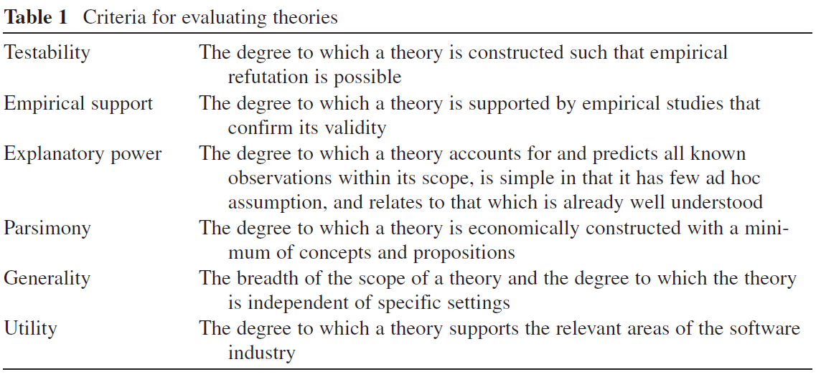
Evaluating Theories
Sjøberg, D.I., Dybå, T., Anda, B.C. and Hannay, J.E., 2008. Building theories in software engineering. In Guide to advanced empirical software engineering (pp. 312-336). Springer, London.

Slide 47
Survey Research and Theory Building
Key Takeaways (Wagner et al., 2020):
C
A
Survey data supports the definition or refinement of constructs, relationships, explanations, and the scope of a theory as well as testing of a theory.
Survey research and theory building are strongly interrelated. The exact relationship depends on whether the theory is descriptive, explanatory, or predictive.
B
D
Theories are of high value to guide the design of surveys.
Use validated scales as much as possible to improve construct validity.

Slide 48
Issues When Assessing Psychological Constructs
Psychological constructs are theoretical concepts to model and understand human behavior, cognition, affect, and knowledge (Binning, 2016)
Examples include happiness, job satisfaction, motivation, commitment, personality, intelligence, skills, and performance
These constructs can only be assessed indirectly
We need ways to proxy our measurement of a construct in robust, valid, and reliable ways
🡪 This is why, whenever we wish to investigate psychological constructs and their variables, we need to either develop or adopt measurement instruments that are psychometrically validated
Scientists have investigated issues of validity and reliability of psychological tests
October 2023
‹#›
Notes:
We cannot take out a ruler to measure the motivation of people.
much research in software engineering has adopted wrong or non-validated psychological tests, and when the right test is adopted, most of the times the test items are modified towards the destruction of the test reliability and validity.
almost half of personality studies in software
engineering use the Myers–Briggs type indicator (MBTI), which has low to none
validity and reliability properties (Pittenger 1993) up to being called as “little more
than an elaborate Chinese fortune cookie” (Hogan 2017).

Slide 49


Validity and Reliability in Psychometrics (AERA et al., 2014)
VALIDITY
RELIABILITY
The degree to which evidence and theory support the interpretation of test scores for proposed uses of tests
We need to ensure that any meaning we provide to the values obtained by a measurement instrument needs to be validated
Consistency of a questionnaire score in repeated instances of it; or
Coefficient between scores on two equivalent forms of the same test
October 2023

Slide 50
Characteristics and Purpose
Software engineering research should favor psychometric validation of tests.
(Wagner et al., 2020)
Wagner, S., Mendez, D., Felderer, M., Graziotin, D. and Kalinowski, M., 2020. Challenges in survey research. In: Contemporary Empirical Methods in Software Engineering (pp. 93-125). Springer, Cham.
October 2023

Slide 51
Issues When Assessing Psychological Constructs
Key Takeaways (Wagner et al., 2020):
C
A
Adoption or development of psychometrically validated questionnaires should consider psychometric validity and reliability issues, which are diverse and very different from the usual and common validity issues we see in “Threats to Validity” sections.
Representing and assessing constructs on human behavior, cognition, affect, and knowledge is a difficult problem that requires psychometrically validated measurement instruments.
B
D
Software engineering research should either adopt or develop psychometrically validated questionnaires.
Software engineering research should introduce studies on the development and validation of questionnaires.

Slide 52
Survey Instrument Evaluation Methods
Used to assess the validity and reliability of the survey instrument
A survey can be evaluated, to avoid threats to validity and reliability, using the following methods (Robson, 2002 apud Linaker et al., 2015):
EXPERT
REVIEWS
FOCUS
GROUPS
PILOT
SURVEYS
COGNITIVE
INTERVIEWS
EXPERIMENTS
October 2023
‹#›
Notes:
Expert reviews -> Survey design expert reviews and subject matter expert reviews.
Focus groups -> gathers a group of people (usually 7 to 8) and asks them survey questions. It allows focus group participants to provide longer answers and
discuss a topic with others.
Pilot studies -> evaluate survey instrumentation like focus groups but additionally they may also evaluate the response rate and follow-up procedures. Usually
conducted well in advance before carrying out the nal survey so that more substantial changes to the questionnaire or procedures can be made.

Slide 53
SAMPLING

Slide 54


Sampling
At the beginning of any design of survey research, we should clarify what the target population is that we try to characterize and generalize to
Statistical analysis relies on systematic sampling from this target population
In software engineering surveys, the unit of analysis that defines the granularity of the target population is often (de Mello et al. 2015)
AN ORGANIZATION
A SOFTWARE TEAM OR PROJECT
AN INDIVIDUAL
October 2023

Slide 55
Sampling
For common research questions, we are typically interested in producing results related to all organizations that develop software in the world or all software developers in the world
We want to find theories that have a scope as wide as possible
We have no solid understanding about the target population
Which companies are developing software?
How many software developers are there in the world?
What are the demographics of software engineers in the world?
We face enormous difficulties to discuss representativeness of a sample, the needed size of the sample and, therefore, to what degree we can generalize our results
October 2023

Slide 56

Representativeness
Scientists often rely on demographic information published by governmental or other public bodies such as statistical offices
These bodies are, so far, rather unhelpful for our task, because they do not provide a good idea about software-developing companies
There are possibilities to approach the demographics of software engineers
Commercial providers of data from large surveys such as Evans Data Corporation
Estimated number of developers worldwide as of 2018: 23 million
Include information on different roles, genders, used development processes and technologies
An open alternative is the Stack Overflow Annual Developer Survey
October 2023

Slide 57

Representativeness
Having demographic information, we can design our survey in a way that we collect comparable data
Then, we can compare the distributions in our survey and the larger surveys to estimate representativeness
A
Should be part of the interpretation and discussion of the results
B
Prevents us from overclaiming
C
Gives us more credibility in case we cover the population well
October 2023

Slide 58
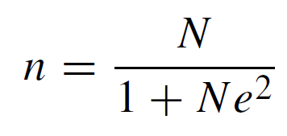
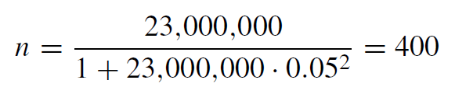
Sample Size Estimation
A good sample size (n) can be estimated as follows (Yamane, 1973 apud Wagner et al., 2020):
n - sample size
N - population size
e - level of precision (often set to 0.05 or 0.01)
Reasonable sample size for software developers (using precision 0.05):
October 2023

Slide 59

Ethics
In software engineering, there is yet no established standard or guidelines on how to conduct surveys ethically
The Insight Association provides ethical guidelines that consider unethical sampling, among other practices: “Collection of respondent emails from Websites, portals, Usenet or other bulletin board postings without specifically notifying individuals that they are being ‘recruited’ for research purposes.”
We will probably need flexible rules and guidelines to keep developers in social media from being spammed by study requests while still allowing research to take place
We should all consider thoughtfully how and whom we contact for a survey study
October 2023
Notes:
In a recent paper, Baltes and Diehl (2016) discuss that the common practice of sending unsolicited e-mails to GitHub developers could be ethically problematic
but we also add to the experience of Baltes and Diehl
(2016) of receiving feedback from potential participants who were annoyed by this.

Slide 60
Sampling
Key Takeaways:
C
A
For individual software engineers, existing demographic studies can be used to assess a survey’s representativeness
There is no suitable official data on the number and properties of software developing companies in the world
B
D
Ethics needs to be considered before contacting potential survey participants
For the estimate of 23 million developers worldwide, a good sample size would be 400 respondents

Slide 61
DATA COLLECTION

Slide 62
Data Collection – Invitation and Follow-up
Strategies to approach the population:
CLOSED INVITATIONS
approaching known groups or individuals to participate per invitation-only
restricting the survey access to those invited
OPEN INVITATIONS
approaching a broader, often anonymous audience via open survey access
anyone with a link to the survey can participate
October 2023
‹#›

Slide 63
Invitation and Follow-up
The strategy has implications on the survey design and the recruitment approaches
CLOSED INVITATIONS
allows to accurately choose the respondents based on predefined characteristics and the suitability to provide the required information
allows to accurately calculate the response rate and control the participation along the data collection
typically implies in a lower number of total responses
OPEN INVITATIONS
allows to spread the invitation broader, e.g., via public forums, mailing lists, social media, or at venues of conferences and workshops.
does not require to carefully select lists of subject candidates and to approach them individually, but it also comes at the cost of loosing control in who provides the responses
requires defining to define proper demographic questions that allow analyzing the extent to which the respondents are suitable to provide the required information
‹#›

Slide 64
Invitation and Follow-up
Key Takeaways (Wagner et al., 2020):
B
A
Both strategies to approach the target population (closed and open invitations) can be applied, but have distinct implications on the survey design and the recruitment approaches.
Closed invitations are suitable in situations in which it is possible to precisely identify and approach a well-defined sample of the target population. They may also be required in situations where filtering out participants that are not part of the target population would be difficult, harming the sample representativeness.
C
Open invitations allow reaching out for larger samples. However, they typically require more carefully considering context factors when designing the survey instruments. These context factors can then be used during the analyses to filter out participants that are not representative (e.g., applying the blocking principle to specific context factors).

Slide 65
STATISTICAL ANALYSIS

Slide 66
Statistical Analysis
DESCRIPTIVE STATISTICS
NULL-HYPOTHESIS SIGNIFICANCE TESTING
BOOTSTRAPPING CONFIDENCE INTERVALS
With the often large number of participants in surveys, we usually aim at a statistical analysis of the survey results
A majority of the questionnaires are typically composed of closed questions that have quantitative results
BAYESIAN ANALYSIS
STRUCTURAL EQUATION MODELING
‹#›
Notes:
Afterwards, we will discuss four alternative approaches to do inference statistics which will help us to interpret the sample results for the whole population.

Slide 67
Descriptive Statistics
The goal of descriptive statistics is to characterize the answers to one or more questions of our specific sample
We do not yet talk about generalizing to the population
Which descriptive statistic is suitable depends on what we are interested in most and the scale of the data
Scale | Nominal | Ordinal | Interval | Ratio
Values Counting | X | X | X | X
Values Ordering |  | X | X | X
Equidistant Intervals |  |  | X | X
Values Division |  |  |  | X
‹#›

Slide 68
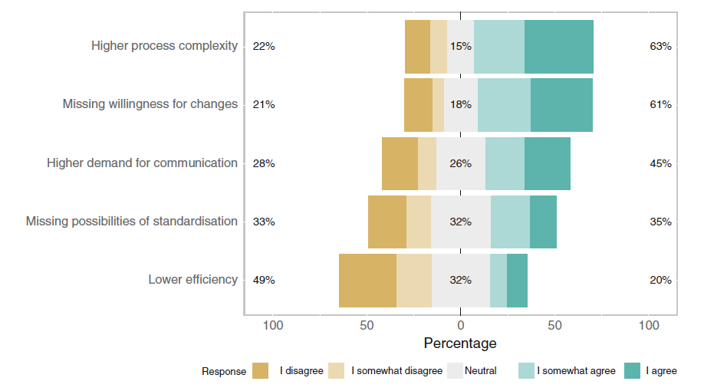
Descriptive Statistics
Descriptive statistics for ordinal scales (e.g., Likert scales)
Frequency counting, mode, median, minimum, maximum, median absolute deviation (MAD), interquartile range (IQR)
An interesting alternative is showing the whole distribution of ordinal data in a stacked bar chart
Generated using the Likert package in R
http://www.labape.com.br/rprimi/statR/T7_plus_likert.html
Wagner et al., 2019
‹#›

Slide 69
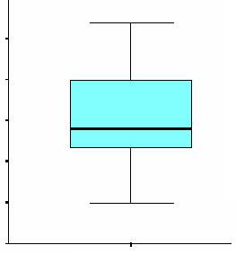
Descriptive Statistics
For interval or ratio scales we can use all available descriptive statistics, such as mean, variance, and standard deviation.
Still, we recommend using boxplots, to enable eliminating outliers by using the quartile method
.
Outliers
.
.
Maximum Value
Quartile Method
Lower Outliers: Q1 - 1.5*IQR
Upper Outliers: Q3 + 1.5*IQR
Where IQR = Q3 – Q1.
3rd Quartile
Median
1st Quartile
Minimum Value
‹#›

Slide 70
Null-hypothesis Significance Testing (NHST)
Descriptive statistics concern the sample
Inference statistics concern the population
We need hypotheses to evaluate
A survey should be guided by a theory
Propositions can be operationalized into hypotheses to test with the survey data
In surveys we typically have:
Point estimate hypotheses for answers to single questions
Hypotheses on correlations between answers to two questions
‹#›

Slide 71
Null-hypothesis Significance Testing (NHST)
In general, two hypotheses are defined:
Null Hypothesis(H0): indicates the observed differences are coincidental. It means that this is the hypothesis the researcher would like most to reject with high confidence
Alternative Hypothesis(H1): represents the hypothesis indicating some type of effect, that can be accepted, or tested
Types of Errors
Type I (α): it happens when the statistical test indicates the existence of a relationship between cause and effect that actually does not exist
Type II (β): it happens when the statistical test does not indicate a relationship between cause and effect that actually does exist
Statistics tests allow confirming or refuting hypotheses (according to a previously defined significance level - α-value)
‹#›

Slide 72
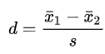
Null-hypothesis Significance Testing (NHST)
Significance Testing
Shows the likelihood of an type-I error to happen
Most common significance level (α): 10%, 5%, 1% and 0.1%
We call p-value the lowest level of significance that can be used to reject the null hypothesis
We say there is statistical significance when the calculated p-value is lower than the adopted significance level (α-value)
Besides significance testing, it is important to also look at effect sizes
Cohen's d is defined as the difference between two means divided by a standard deviation for the data
‹#›

Slide 73
Null-hypothesis Significance Testing (NHST)
Several statistical significance tests can be applied, with differences in their statistical power
(Power= P (H₀ rejected | H_{o} is false))
The statistical test with the highest power shall be used to evaluate the hypotheses
Normal Distribution Data
Pearson
Linear Regression
Relationship
Exploration
Non Normal Distribution Data
Spearman
Non-Linear Regression
2 groups
t-test
paired Student's t-test
Normal Distribution Data
3+ groups
ANOVA, Tukey
Hypothesis Testing
2 groups
Mann-Whitney (Wilcoxon rank-sum test)
Wilcoxon signed-rank test
Non Normal Distribution Data
3+ groups
Kruskal-Wallis

Slide 74

Null-hypothesis Significance Testing (NHST)
Problems with NHST
Dichotomous nature of its results
Requires a representative sample of the population, otherwise it is unclear what NHST actually means
We need alternatives ...

Slide 75
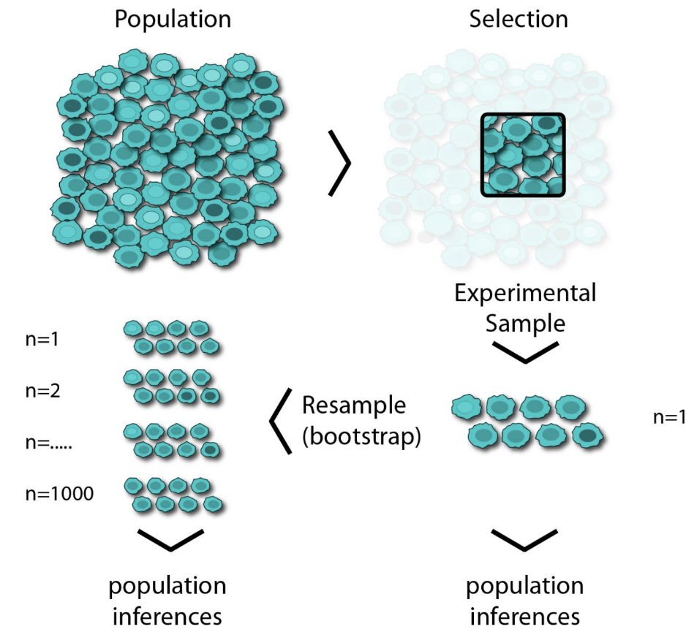
Bootstrapping Confidence Intervals
Replaces fixed significance level tresholds
Involves estimating a confidence interval around a metric we are interested in
How large is the confidence interval?
How strongly do confidence intervals of methods to compare overlap?
Idea of bootstrapping:
We repeatedly take samples with replacement and calculate the statistic we are interested in
This is repeated a large number of times and, thereby, provides us with an understanding of the distribution of the sample
Source: https://medium.com/swlh/bootstrap-sampling-using-pythons-numpy-85822d868977

Slide 77
Bootstrapping Confidence Intervals: Example
1000 times resampling for bootstrapping confidence intervals
The Bootstrap Assumption: The original sample approximates the population from which it was drawn. So resamples from this sample approximate what we would get if we took many samples from the population. The bootstrap distribution of a statistic, based on many resamples, approximates the sampling distribution of the statistic, based on many samples.

Slide 78
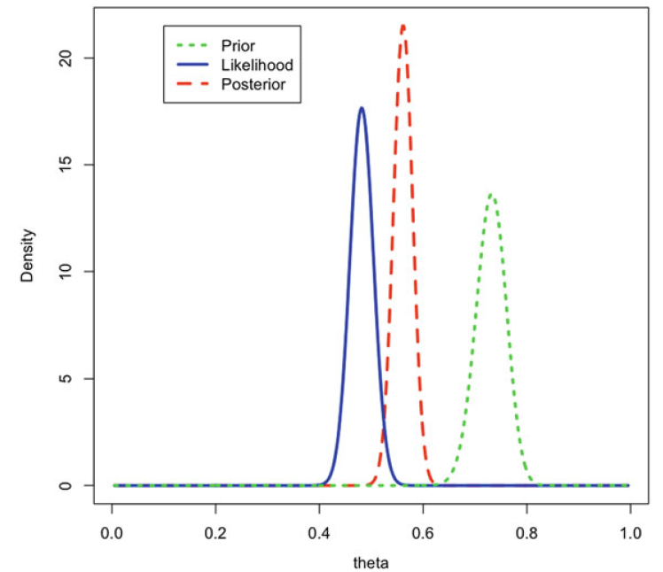
Bayesian Analysis
In Bayesian statistics, probability is understood as a representation of the state of knowledge or belief
Acknowledges uncertainty
Allows integrating existing evidence and accumulating knowledge
Further Reading:
Torkar, R., Feldt, R. and Furia, C.A., 2020. Bayesian Data Analysis in Empirical Software Engineering: The Case of Missing Data. In Contemporary Empirical Methods in Software Engineering (pp. 289-324). Springer, Cham.
NaPiRE
run 3
NaPiRE
run 2
Workshops for eliciting requirements (Wagner et al., 2020)

Slide 79
Structural Equation Modeling
Structural Equation Modeling (SEM) is used to test theories involving constructs (also called latent variables).
In our Pandemic Programming survey example fear, disaster preparedness, home office ergonomics, wellbeing and productivity are all constructs
To design a structural equation model, we first define a measurement model, which maps each reflective indicator into its corresponding construct.
For example, each of the five items comprising the WHO5 wellbeing scale is modeled as a reflective indicator of wellbeing
SEM uses Confirmatory Factor Analysis (CFA) to estimate each construct as the shared variance of its respective indicators

Slide 80
Structural Equation Modeling
Next, we define the structural model, which identifies the expected relationships among the constructs
The constructs we are attempting to predict are referred to as endogenous (dependent variables), while the predictors are exogenous (independent variables)
SEM uses a path modeling technique (e.g. regression) to build a model that predicts the endogenous (latent) variables based on the exogenous variables, and to estimate both the strength of each relationship and the overall accuracy of the model

Slide 82
Structural Equation Modeling Example: Pandemic Programming
SUPPORTED MODEL
The arrows between the constructs show the supported causal relationships.
The path coefficients (the numbers on the arrows) indicate the relative strength and direction of the relationships.
Ralph, P., Baltes, S., Adisaputri, G., Torkar, R., Kovalenko, V., Kalinowski, M., Novielli, N., Yoo, S., Devroey, X., Tan, X., Zhou, M., Turhan, B., Hoda, R., Hata, H., Robles, G., Fard, A. M., and Alkadhi, R, Pandemic Programming How COVID-19 affects software developers and how their organizations can help. Empirical Software Engineering (2020), 25: 4927-4961. 2020.
October 2023
Marcos Kalinowski © DI PUC-Rio
Notes:
The literal definition of a partial regression coefficient is the expected change in the dependent variable associated with a unit change in a given predictor while controlling for the correlated effects of other predictors.
In summary, all diagnostics indicate the model is safe to interpret (i.e. CFI = 0.961, RMSEA = 0.051, SRMR = 0.067).

Slide 83
Statistical Analysis
Key Takeaways (Wagner et al., 2020):
A
C
Always make clear whether you aim at analyzing opinions or facts
B
NHST inferential statistics are useful to test theoretical propositions
Descriptive statistics are always helpful
D
E
Bootstrapping confidence intervals helps to deal with uncertain sampling
Bayesian analysis allows us to directly integrate prior knowledge
F
Structural equation modeling (SEM) is a powerful multivariate analysis technique that is widely used in the social sciences and that should be further used in computer science research

Slide 84
QUALITATIVE ANALYSIS

Slide 85

Qualitative Analysis
Besides the common focus on statistical analysis, surveys can also be qualitative and contain open questions
Open questions do not impose restrictions on respondents and allow them to more precisely describe the phenomena of interest according to their perspective and perceptions
However, they can lead to a large amount of qualitative data to analyze, which is not easy and may require a significant amount of resources
‹#›

Slide 86



Qualitative Analysis
The answers to such open questions can help researchers to further understand a phenomenon eventually including causal relations among theory constructs and theoretical explanations
Open questions can help generating new theories
There are at least three main streams of GT:
Glaser’s GT (classic or Glaserian GT) (Glaser, 1992)
Corbin and Strauss’ GT (Straussian GT) (Corbin and Strauss, 1990)
Charmaz’s constructivist GT (Charmaz, 2014)
A research method commonly employed to support qualitative analyses is Grounded Theory.
Grounded theory, “in theory”, involves inductively generating theory from data.
Few “GT” Studies Generate Theory (Stol et al., 2016)
‹#›

Slide 87
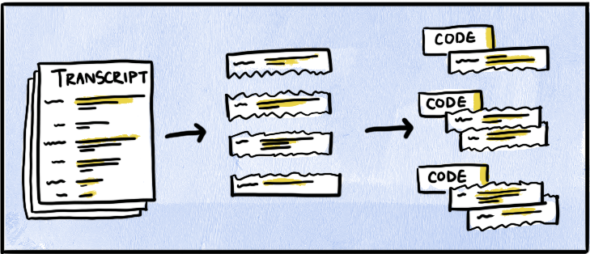
Open Coding
1
2
Turn your data into small, discrete components of data
Code each discrete pieces of data with a descriptive label
Source: https://delvetool.com/blog/openaxialselective
Corbin, J.M. and Strauss, A., 1990. Grounded theory research: Procedures, canons, and evaluative criteria. Qualitative sociology, 13(1), pp.3-21.
‹#›

Slide 88
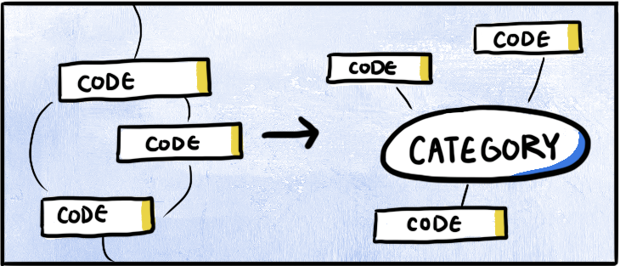
Axial Coding
3
4
Find connections and relationships between codes
Aggregate and condense codes into broader categories
Source: https://delvetool.com/blog/openaxialselective
Corbin, J.M. and Strauss, A., 1990. Grounded theory research: Procedures, canons, and evaluative criteria. Qualitative sociology, 13(1), pp.3-21.
‹#›

Slide 89
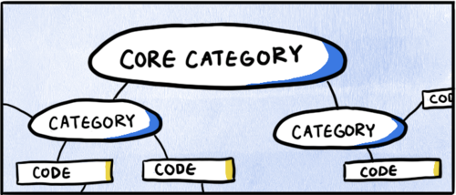
Selective Coding
5
Bring it together with one overarching category
6
Identify the connections between this overarching category and the rest of your codes and data
7
Remove categories or codes that don’t have enough supporting data
Source: https://delvetool.com/blog/openaxialselective
8
Read the transcript again, and code according to this overarching category
Corbin, J.M. and Strauss, A., 1990. Grounded theory research: Procedures, canons, and evaluative criteria. Qualitative sociology, 13(1), pp.3-21.
‹#›

Slide 91
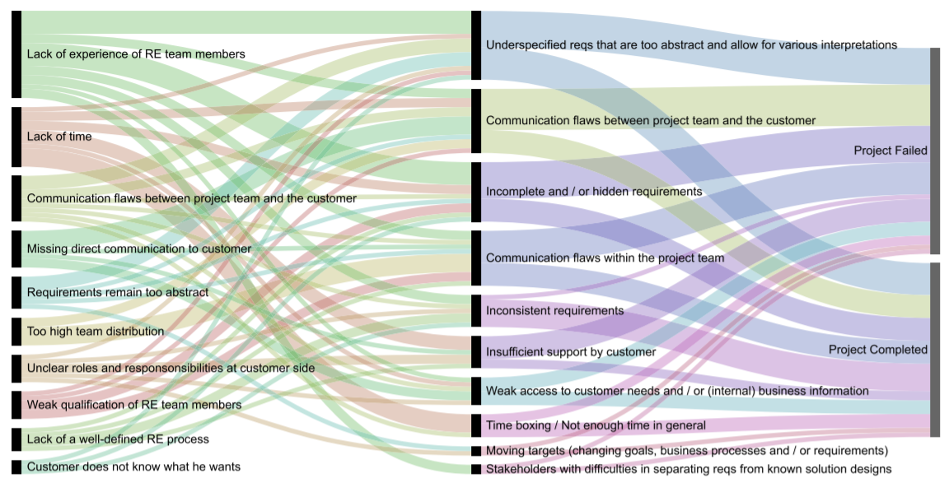
Qualitative Analysis: Example
Fernández, D. M.; Wagner, S.; Kalinowski, M.; Felderer, M.; Mafra, P.; Vetro, A.; Conte, T.; Christiansson, M.; Greer, D.; Lassenius, C.; Männistö, T.; Nayabi, M.; Oivo, M.; Penzenstadler, B.; Pfahl, D.; Prikladnicki, R.; Ruhe, G.; Schekelmann, A.; Sen, S.; Spínola, R. O.; Tuzcu, A.; de la Vara, J. L.; and Wieringa, R. Naming the pain in requirements engineering - Contemporary problems, causes, and effects in practice. Empirical Software Engineering, 22(5): 2298-2338. 2017.
‹#›

Slide 92
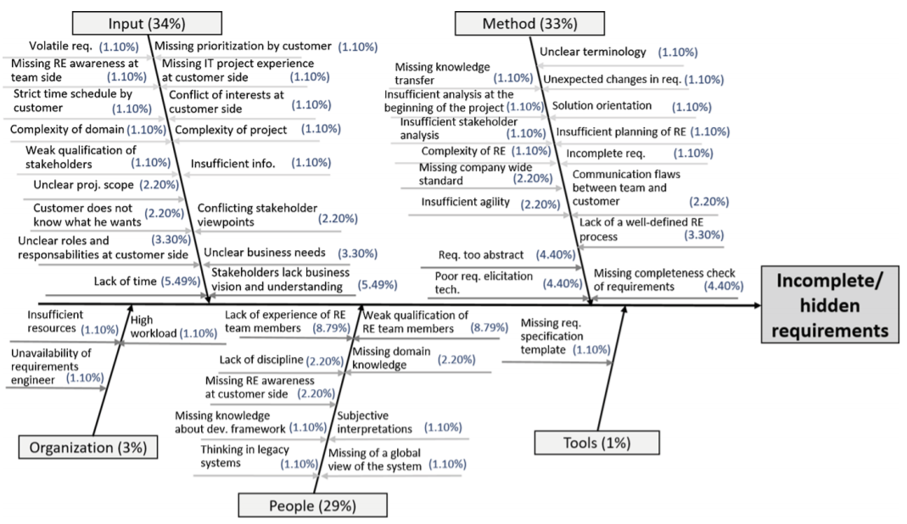
Qualitative Analysis: Example
Fernández, D. M.; Wagner, S.; Kalinowski, M.; Felderer, M.; Mafra, P.; Vetro, A.; Conte, T.; Christiansson, M.; Greer, D.; Lassenius, C.; Männistö, T.; Nayabi, M.; Oivo, M.; Penzenstadler, B.; Pfahl, D.; Prikladnicki, R.; Ruhe, G.; Schekelmann, A.; Sen, S.; Spínola, R. O.; Tuzcu, A.; de la Vara, J. L.; and Wieringa, R. Naming the pain in requirements engineering - Contemporary problems, causes, and effects in practice. Empirical Software Engineering, 22(5): 2298-2338. 2017.
‹#›

Slide 93
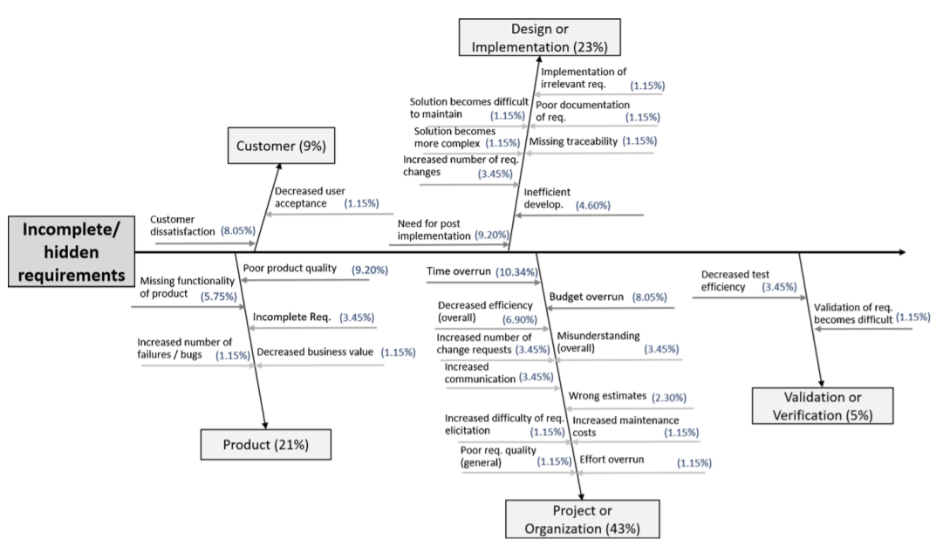
Qualitative Analysis: Example
Fernández, D. M.; Wagner, S.; Kalinowski, M.; Felderer, M.; Mafra, P.; Vetro, A.; Conte, T.; Christiansson, M.; Greer, D.; Lassenius, C.; Männistö, T.; Nayabi, M.; Oivo, M.; Penzenstadler, B.; Pfahl, D.; Prikladnicki, R.; Ruhe, G.; Schekelmann, A.; Sen, S.; Spínola, R. O.; Tuzcu, A.; de la Vara, J. L.; and Wieringa, R. Naming the pain in requirements engineering - Contemporary problems, causes, and effects in practice. Empirical Software Engineering, 22(5): 2298-2338. 2017.
‹#›

Slide 94
Qualitative Analysis
Key Takeaways (Wagner et al., 2020):
C
A
When preparing your survey, invest effort in avoiding confounding factors that may interfere in having respondents focusing mainly on the survey question when providing their answers (e.g., language issues). Assess the instrument validity.
When reporting the qualitative analysis of your survey, explicitly state your research method, providing details on eventual deviations.
D
B
To avoid researcher bias and improve the reliability of the results, qualitative analyses should be conducted in teams and make use of independent validations. Also, ideally the raw and analyzed data should be open to enable other researchers to replicate the analysis procedures.
Applying coding and analysis techniques from Grounded Theory can help to understand qualitative data gathered through open questions.

Slide 95
THREATS TO VALIDITY AND RELIABILITY

Slide 96
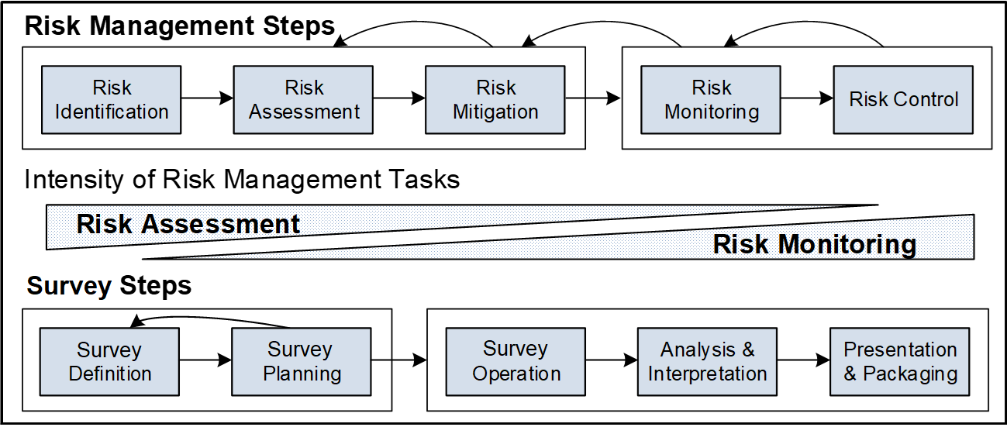
Survey Risk Management
Validity is a property of inferences and every study faces Threats to Validity (Biffl et al., 2014)
Biffl, S., Kalinowski, M., Ekaputra, F., Neto, A.A., Conte, T. and Winkler, D., 2014, September. Towards a semantic knowledge base on threats to validity and control actions in controlled experiments. In Proceedings of the 8th ACM/IEEE International Symposium on Empirical Software Engineering and Measurement (pp. 1-4).
‹#›

Slide 97

Validity Assessment
In psychometrics, validity concerns “the degree to which evidence and theory support the interpretation of test scores for proposed uses of tests” (AERA et al., 2014)
Rust (2009) summarized six facets of validity in the context of psychometric tests:
FACE VALIDITY
CONTENT VALIDITY
(aka criterion validity in this context)
PREDICTIVE VALIDITY
CONCURRENT VALIDITY
CONSTRUCT VALIDITY
DIFFERENTIAL VALIDITY
‹#›
Notes:
Face validity concerns how the items of a measurement instrument are accepted by respondents. This is mostly about wording and meaning of the test questions and how they are perceived by participants.
Content validity (also known as criterion validity or domain-referenced validity)
reflects how a test fits the purposes for which it was developed.
Predictive validity is assessed with the correlation between the score of a
measurement instrument and a score of the degree of success in the real world.
Concurrent validity is defined as the correlation of a new measurement instrument
and already existing measurement instruments for the same construct
Construct validity is a major validity criterion. Constructs are not directly
measurable; therefore, one way to assess how valid a measurement instrument is
is to observe the relationship between the test and the phenomena that the test
attempts to represent.
Differential validity assesses how scores of a test correlate with measures they
should be related to, and how scores of a test do not correlate with measures they
should not be related to.

Slide 98
Validity Assessment
In software engineering we typically aim at assessing whether it is possible to safely conclude that a survey measures what it is supposed to
FACE VALIDITY
CONTENT VALIDITY
Typically involves a lightweight review of the questionnaire by randomly chosen respondents
Typically involves having a (focus) group of reviewers evaluating the questionnaire. The group should include subject matter experts and example respondents from the target population
The following validity types are discussed in this context (Kitchenham and Pfleeger, 2008 apud Linaker et al., 2015):
CRITERION VALIDITY
CONSTRUCT VALIDITY
Refers to how the questionnaire can separate between respondents that belong to different groups. An existing classification and mapping of the different groups in the target population must be in place
validity is how well the question actually measures the construct it was intended to by the designer
‹#›

Slide 99
Reliability Assessment
Reliability (aka External Validity and Generalizability):
TEST-RETEST RELIABILITY
The same subject responds to the same survey two times, and it is measured whether the subject gives the same answers each time
Kitchenham and Peeger (2008) state that if the correlation between both of the answers is greater than 0.7 the test-retest reliability can be considered good
INTER-OBSERVER RELIABILITY
Assesses observer interview bias in not self-administered surveys
Assesses observer analysis bias (e.g., when interpreting and decoding open ended questions)
Typically addressed by having two or more observers involved in the interview and analysis process
PHRASING / REORDER EFFECT RELIABILITY
Testing whether the phrasing or reordering of questions has any effect on the answers by a respondent (assesses instrument bias on the respondent)
STATISTICAL GENERALIZABILITY
If conclusions are to be drawn on the whole population, not just on the sample, the reliability needs to be proven and established
‹#›
Notes:
Expert reviews -> Survey design expert reviews and subject matter expert reviews.
Focus groups -> gathers a group of people (usually 7 to 8) and asks them survey questions. It allows focus group participants to provide longer answers and
discuss a topic with others.
Pilot studies -> evaluate survey instrumentation like focus groups but additionally they may also evaluate the response rate and follow-up procedures. Usually
conducted well in advance before carrying out the nal survey so that more substantial changes to the questionnaire or procedures can be made.

Slide 101
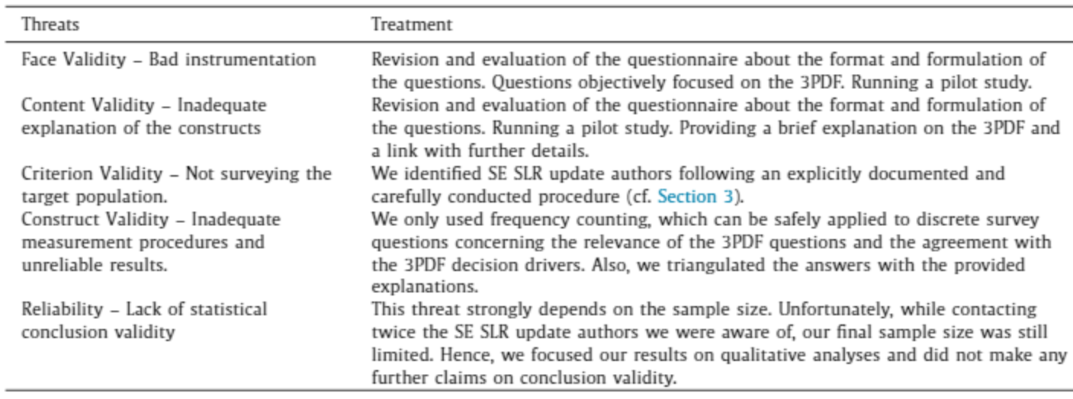
Threats to Validity and Reliability (Example)
Mendes, E., Wohlin, C., Felizardo, K. and Kalinowski, M., 2020. When to update systematic literature reviews in software engineering. Journal of Systems and Software, 167, p.110607.
‹#›

Slide 102
HANDS-ON EXERCISE

Slide 103

Developing a Short Survey
Objective: Develop a survey relating Happiness with Perceived Productivity for Software Engineering Professionals.
Individual Preparation (15min)
Take notes on:
Demographic information
Constructs
Hypotheses (Propositions)
Team Discussion (15min)
Use the Interactive Miro Board to discuss relevant demographic information, constructs, and hypotheses with the remaining participants.
Material:
Scale of Positive and Negative Experience (SPANE) for Hapiness (http://labs.psychology.illinois.edu/~ediener/SPANE.html)
WHO’s Health and Work Performance Questionnaire (HPQ) for Perceived Performance (https://www.hcp.med.harvard.edu/hpq/info.php)
Stack Overflow Survey for Demographics (https://insights.stackoverflow.com/survey/2021)

Slide 104
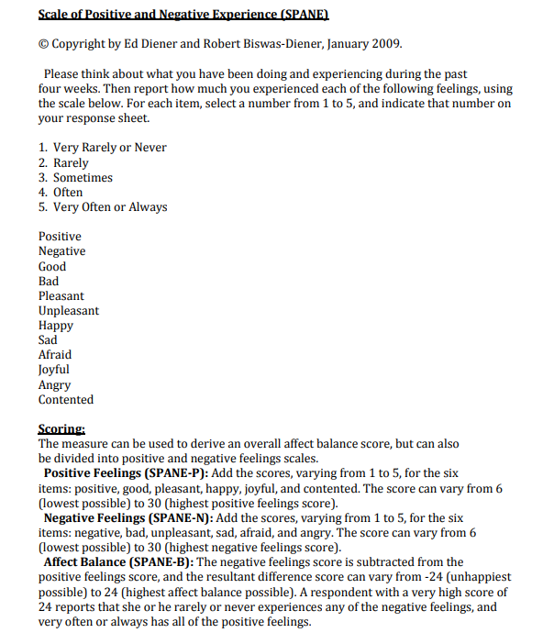
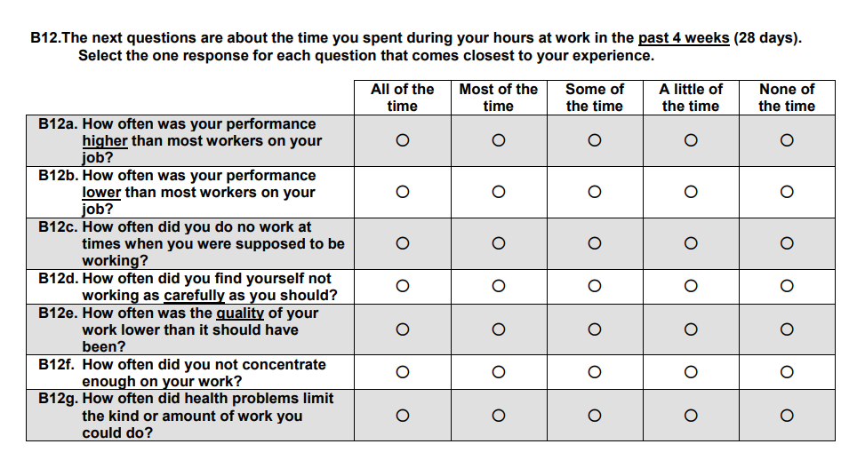
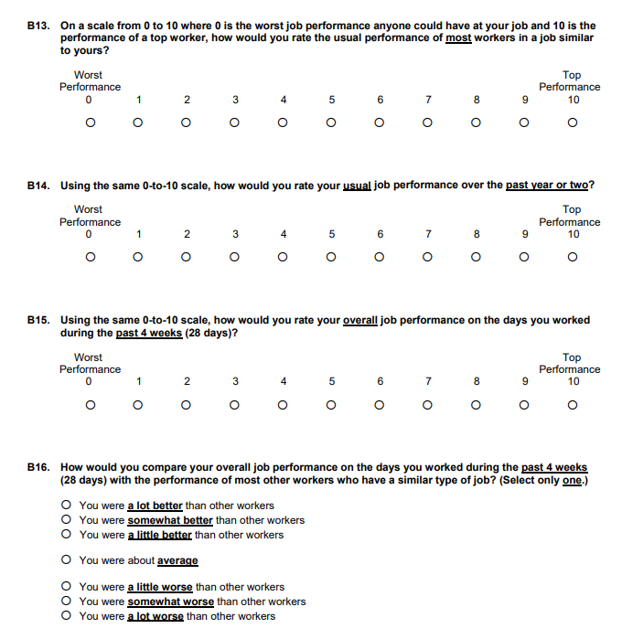
SPANE
HPQ

Slide 105
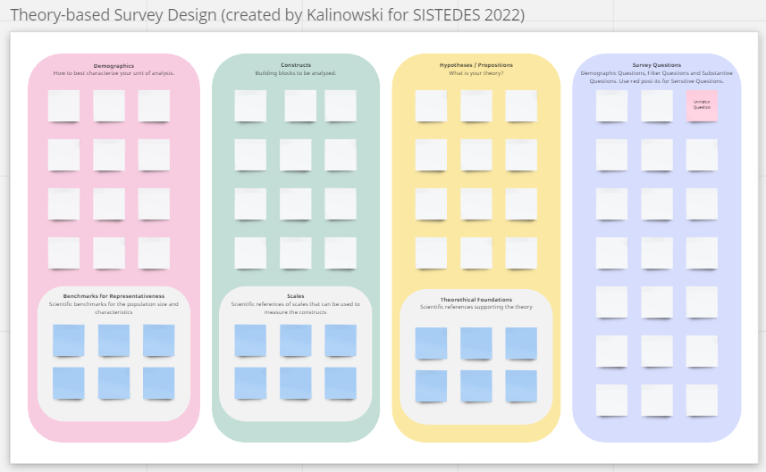
Exercise Discussion
https://miro.com/app/board/uXjVPZDlxGo=/

Slide 106
References
AERA, APA, NCME (2014) Standards for educational and psychological testing. American Educational Research Association, Washington
Basili, V.R. and Rombach, H.D., 1988. The TAME project: Towards improvement-oriented software environments. IEEE Transactions on software engineering, 14(6), pp.758-773.
Batista, M., Magdaleno, A. and Kalinowski, M., 2017, May. A Survey on the use of Social BPM in Practice in Brazilian Organizations. In Anais do XIII Simpósio Brasileiro de Sistemas de Informação (pp. 436-443). SBC.
Biffl, S., Kalinowski, M., Ekaputra, F., Neto, A.A., Conte, T. and Winkler, D., 2014, September. Towards a semantic knowledge base on threats to validity and control actions in controlled experiments. In Proceedings of the 8th ACM/IEEE International Symposium on Empirical Software Engineering and Measurement (pp. 1-4).
Binning JF (2016) Construct. https://www.britannica.com/science/construct
Charmaz, K. 2014. Constructing Grounded Theory. Sage, 2nd Ed.
Corbin, J.M. and Strauss, A., 1990. Grounded theory research: Procedures, canons, and evaluative criteria. Qualitative sociology, 13(1), pp.3-21.
Fernández, D. M.; Wagner, S.; Kalinowski, M.; Felderer, M.; Mafra, P.; Vetro, A.; Conte, T.; Christiansson, M.; Greer, D.; Lassenius, C.; Männistö, T.; Nayabi, M.; Oivo, M.; Penzenstadler, B.; Pfahl, D.; Prikladnicki, R.; Ruhe, G.; Schekelmann, A.; Sen, S.; Spínola, R. O.; Tuzcu, A.; de la Vara, J. L.; and Wieringa, R. Naming the pain in requirements engineering - Contemporary problems, causes, and effects in practice. Empirical Software Engineering, 22(5): 2298-2338. 2017.
Fowler Jr, F.J., 2013. Survey research methods. Sage publications.
Genero, M., Cruz-Lemus, J.A. y Piattini, M., 2014. Métodos de investigación en ingeniería del software. Ed. RA-MA.
Glaser, B.G. 1992. Basics of Grounded Theory Analysis: Emergence vs Forcing. Sociology Press.
Graziotin, D. and Fagerholm, F., 2019. Happiness and the productivity of software engineers. In Rethinking Productivity in Software Engineering (pp. 109-124). Apress, Berkeley, CA.
Hannay, J.E., Sjoberg, D.I. and Dyba, T., 2007. A systematic review of theory use in software engineering experiments. IEEE transactions on Software Engineering, 33(2), pp.87-107.
‹#›

Slide 107
References
Kalinowski, M., Weber, K., Santos, G., Franco, N., Duarte, V. and Travassos, G., 2015. Software Process Improvement Results in Brazil Based on the MPS-SW Model. Software Quality Professional, 17(4): 15-28.
Kalinowski, M., Weber, K., Franco, N., Barroso, E., Duarte, V., Zanetti, D. and Santos, G., 2014, September. Results of 10 years of software process improvement in Brazil based on the MPS-SW model. In 2014 9th International Conference on the Quality of Information and Communications Technology (pp. 28-37).
Kalinowski, M., Weber, K.C. and Travassos, G.H., 2008, October. iMPS: an experimentation based investigation of a nationwide software development reference model. In Proceedings of the Second ACM-IEEE international symposium on Empirical Software Engineering and Measurement (ESEM).
Kitchenham, B.A. and Pfleeger, S.L., 2008. Personal opinion surveys. In Guide to advanced empirical software engineering (pp. 63-92). Springer, London.
Kuhrmann, M., Tell, P., Hebig, R. et al. What Makes Agile Software Development Agile? Submitted to Transactions on Software Engineering (2021).
Linåker, J., Sulaman, S.M., Maiani de Mello, R. and Höst, M., 2015. Guidelines for conducting surveys in software engineering. Technical Report.
Mendes, E., Wohlin, C., Felizardo, K. and Kalinowski, M., 2020. When to update systematic literature reviews in software engineering. Journal of Systems and Software, 167, p.110607.
Mendoza, I., Kalinowski, M., Souza, U. and Felderer, M., 2019, January. Relating verification and validation methods to software product quality characteristics: results of an expert survey. In Proc. of the Software Quality Days Conference (SWQD) (pp. 33-44). Springer, Cham.
de Mello RM, da Silva PC, Travassos GH (2015) Investigating probabilistic sampling approaches for large-scale surveys in software engineering. Journal of Software Engineering Research and Development, 3(1):8.
Ralph, P., Baltes, S., Adisaputri, G., Torkar, R., Kovalenko, V., Kalinowski, M., Novielli, N., Yoo, S., Devroey, X., Tan, X., Zhou, M., Turhan, B., Hoda, R., Hata, H., Robles, G., Fard, A. M., and Alkadhi, R, Pandemic Programming How COVID-19 affects software developers and how their organizations can help. Empirical Software Engineering (2020), 25: 4927-4961. 2020.
‹#›

Slide 108
References
Robson, C., (2002) Real World Research - A Resource for Social Scientists and Practitioner-Researchers, 2nd ed. Malden: Blackwell Publishing.
Rust J (2009) Modern psychometrics: the science of psychological assessment. Routledge, Hove, East Sussex New York
Sjøberg, D.I., Dybå, T., Anda, B.C. and Hannay, J.E., 2008. Building theories in software engineering. In Guide to advanced empirical software engineering (pp. 312-336).
Stol, K.J., Ralph, P. and Fitzgerald, B., 2016, May. Grounded theory in software engineering research: a critical review and guidelines. In Proceedings of the 38th International Conference on Software Engineering (pp. 120-131).
Torkar, R., Feldt, R. and Furia, C.A., 2020. Bayesian Data Analysis in Empirical Software Engineering: The Case of Missing Data. In Contemporary Empirical Methods in Software Engineering (pp. 289-324). Springer, Cham.
Travassos, G.H. and Kalinowski, M., 2014. iMPS 2013: Evidence on performance of organizations that adopted the MPS-SW. Campinas, Brazil: Softex.
Wagner, S., Mendez, D., Felderer, M., Graziotin, D. and Kalinowski, M., 2020. Challenges in survey research. In: Contemporary Empirical Methods in Software Engineering (pp. 93-125). Springer, Cham.
Wagner, S., Fernández, D. M., Felderer, M., Vetro, A., Kalinowski, M., Wieringa, R., Pfahl, D., Conte, T., Christiansson, M., Greer, D., Lassenius, C., Männistö, T., Nayebi, M., Oivo, M., Penzenstadler, B., Prikladnicki, R., Ruhe, G., Schekelmann, A., Sen, S., Spínola, R.O., Tuzcu, A., de la Vara, J. L., and Winkler, D, Status Quo in Requirements Engineering: A Theory and a Global Family of Surveys. ACM Transactions on Software Engineering and Methodology, 28(2): 9:1-9:48. 2019.
Wohlin, C., Runeson, P., Höst, M., Ohlsson, M.C., Regnell, B. and Wesslén, A., 2012. Experimentation in software engineering. Springer Science & Business Media.
‹#›

Slide 109
SURVEY RESEARCH METHODS IN SOFTWARE ENGINEERING
Prof. Marcos Kalinowski
kalinowski@inf.puc-rio.br
http://www.inf.puc-rio.br/~kalinowski
@prof_kalinowski

Slide 110
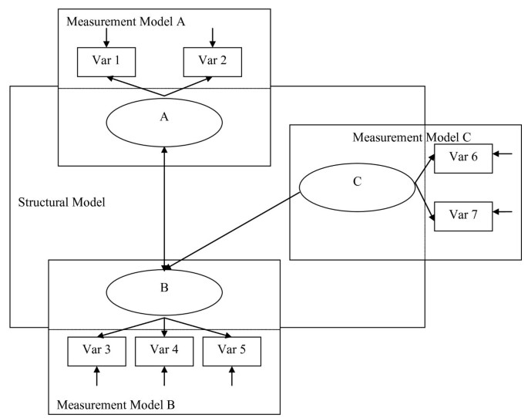
Notes:
https://bmcresnotes.biomedcentral.com/articles/10.1186/1756-0500-3-267#Sec9
https://www.researchgate.net/post/SEM-interpretation-how-to-interpret-standerized-regression-weights

